Slide 1

Assignment2: An online meeting booking system
G33
Lekun.Liu 2255714
Yiyang.Han 2252155
Junhao.Huang 2256792
Yichuan.Zhang 2251668
Tiantian.Ye 2251663
Ruiyang.Wu 2257387
Daiyan.Wu 2257475
Weizhe.Sun 1927150
Xuning.Hu 2251992

Slide 2
Overview
Part 1
Part 2
Part 3
Part 4
Part 5
Introduction
& Background
Architectural
Design
Software Design
Software
Testing
Project Conclusion

Slide 3

Introduction & Background
The development of a web-based online meeting booking system for a university's meeting room management
A high-quality, efficient, user-friendly, and secure system that enables convenient management and meeting room reservations
All customer’s specification
Aims of our project

Slide 4
Introduction & Background
Efficient meeting room reservation process
Real-time access to room availability
Clear room descriptions
Photos of meeting rooms
Email confirmation and notification for
registration
Staff and student users
Regular Access
User Characteristics
Manage feedback and maintenance Requests
Manage meeting rooms, equipment, booking
approvals, and user permissions
Administrator
Superior Access
Integration Complexity: Compatibility risks with Spring Boot, MySQL, Qiniu, etc.
Usability Challenges: Unintuitive filters, calendar, or email flow may reduce adoption
Data Breach & Unauthorized Access: Weak session or password handling can expose user data
Injection Vulnerabilities: No rate limit on email code requests may lead to spamming
Ethical Considerations: Mishandling student data may violate university or privacy laws
Project Risks

Slide 5
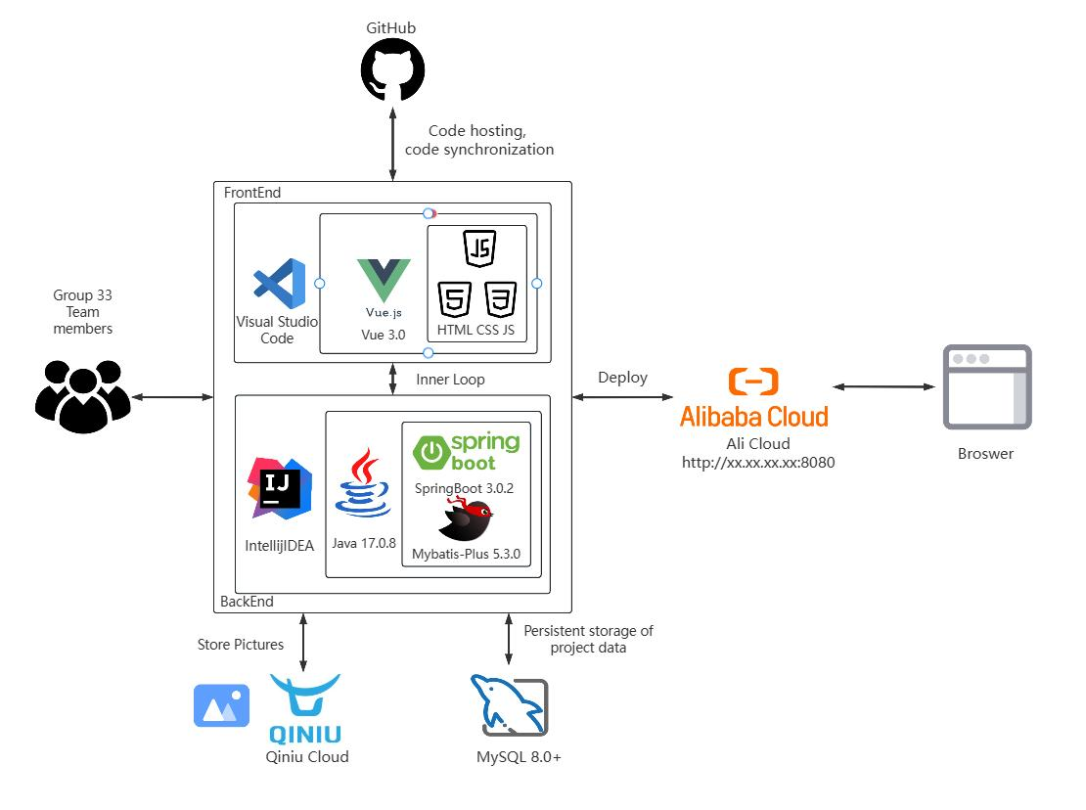
Architectural Design
Four key requirement
Reliability
Performance
Usability
Security
System Components
Frontend: Vue 2, HTML, CSS, JavaScript Backend: Spring Boot 3.0.2, MyBatis-Plus 3.5.3 Database: MySQL 8.0+ OSS: Qiniu Cloud Deployment: Nginx Communication: Axios HTTP Client

Slide 6
Architectural Design
HTML, CSS, JavaScript
Manages stateful user interactions
Component-Based Architecture
Enhances frontend scalability and maintainability
Frontend Technology & Justification
Promise-based HTTP client
Handles backend requests more efficiently
Request and response interception
Streamlined error handling and better code organization
Axios HTTP Client

Slide 7
Architectural Design
Spring Boot
Project foundation
Centralized config
Simplified ORM for SQL mapping and CRUD
Wrapper-based query construction, improving readability.
MyBatis Plus
Backend Technologies & Justification
Lombok
Automatically Generate Standard Code
Enhancing Code Readability and Maintainability
Caffeine
Lightweight local cache to enhance system performance
High concurrency and low latency for frequent data
Qiniu OSS
Image storage integration via secure object storage Supports file upload and CDN delivery with minimal setup
Knife4j provides API documentation UI for RESTful services
Allows interactive API exploration with parameter editing and live response
Knife4j

Slide 8
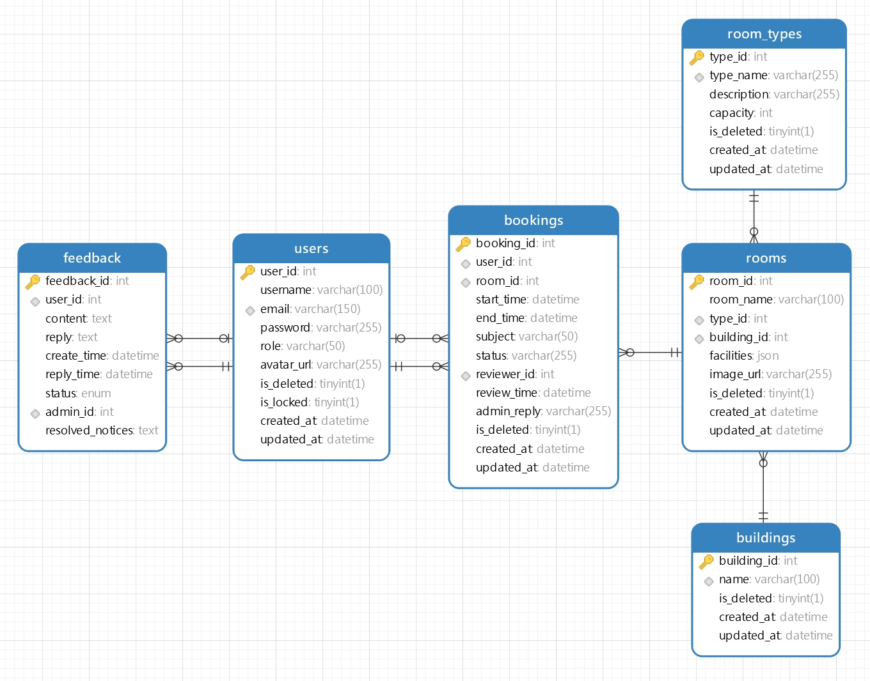
Architectural Design
High-level Database Design
users to bookings: 1:M
users to feedback: 1:M
rooms to bookings: 1:M
room_types to rooms: 1:M
buildings to rooms: 1:M
Entity Relationships

Slide 9
Software Design
Software Modules
Authentication Module
User Module
Booking Management Module
Feedback Module
Room Management Module

Slide 10
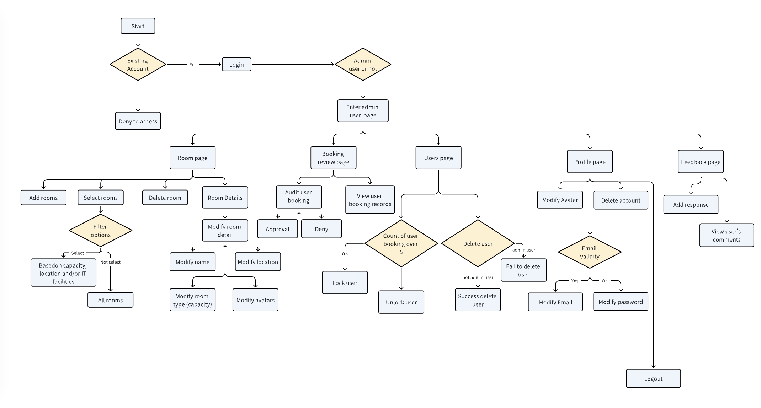
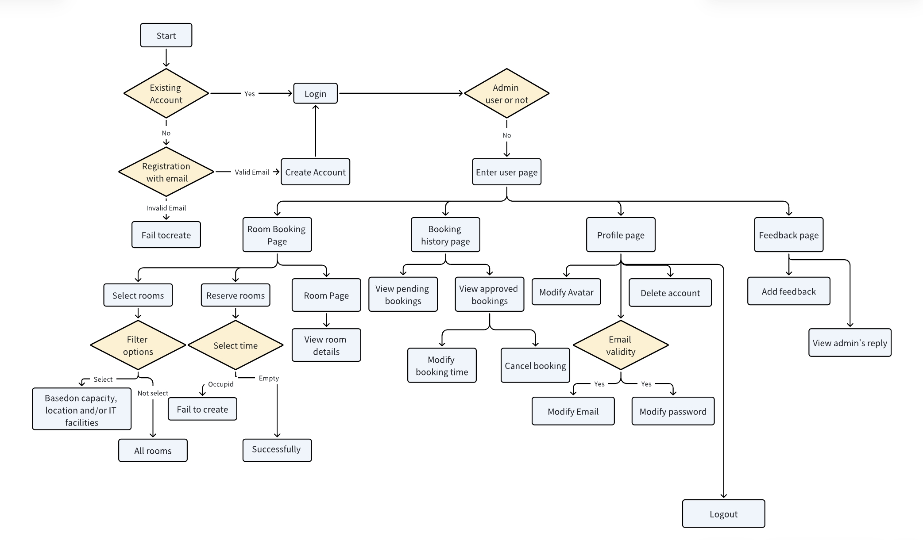
Software Design
High-level process flow
Admin sequence flow diagram
User sequence flow diagram

Slide 11
Software Design
MySQL provides relational data storage
MyBatis-Plus simplifies ORM with built-in CRUD
QueryWrapper supports dynamic query building in Java
Database Services
Caffeine Cache stores short-lived data
Hutool Toolkit enables string, file, and object utilities
Caching & Utility Services
Security & Email Services
Passwords hashed via MD5 + Salt, rate-limited Captcha
Email verification sent via NetEase 163 SMTP
Software Support Service
Qiniu Cloud stores user avatars and room images
Supports CDN acceleration & lifecycle management
Cloud Storage & CDN
IntelliJ IDEA (backend) & VS Code (frontend)
Version control with Git + GitHub, CI pipelines for pre-merge validation
Development & Deployment Tooling
RESTful APIs documented via Swagger / Knife4j
Community & troubleshooting support via Stack Overflow and official docs
Documentation & Support

Slide 12
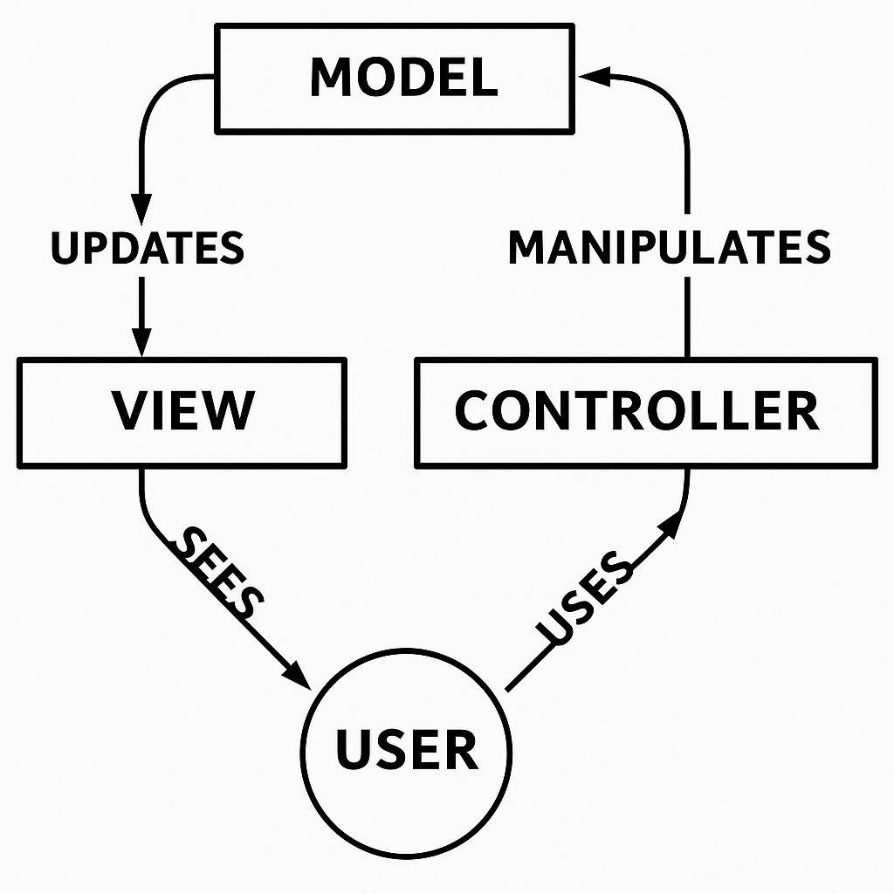
Software Design
Coding Structure
5 Core Principles:
MVC Architecture
Separation of concerns
High cohesion & Low coupling
Maintainability
Testability
RESTful API design
Layered Architecture:
Controller Layer: Handles HTTP requests
Service Layer: Contains business logic and Mapper Layer SQL abstraction via MyBatis interfaces
Model Layer: Entity classes mapped to DB; DTOs/VOs used for I/O transformation

Slide 13
Software Design
Shared Functional Packages
Shared functional packages help organize reusable logic, simplify configuration, and ensure consistency across the system—making the codebase cleaner, more modular, and easier to maintain.
common/ – Shared tools for response, email, and rate limiting
config/ – Centralized project configuration
constant/ – Global enums for roles and status codes
exception/ – Unified error handling structure
annotation + aop/ – Declarative access control with AOP(Aspect-Oriented Programming)
Coding Conventions
Unified naming
Strict API contracts
Typed errors
Javadoc, logging, and pre-commit linting
Agile workflow with short sprints, CI, code reviews, and daily stand-ups

Slide 14
Software Design
Coding Structure and Convention
Shared functional packages help organize reusable logic, simplify configuration, and ensure consistency across the system—making the codebase cleaner, more modular, and easier to maintain.
Shared Functional Packages
common/ – Shared tools for response, email, and rate limiting
config/ – Centralized project configuration
constant/ – Global enums for roles and status codes
exception/ – Unified error handling structure
annotation + aop/ – Declarative access control with AOP

Slide 15
Software Testing
Coding Structure and Convention
Shared Functional Packages

Slide 16
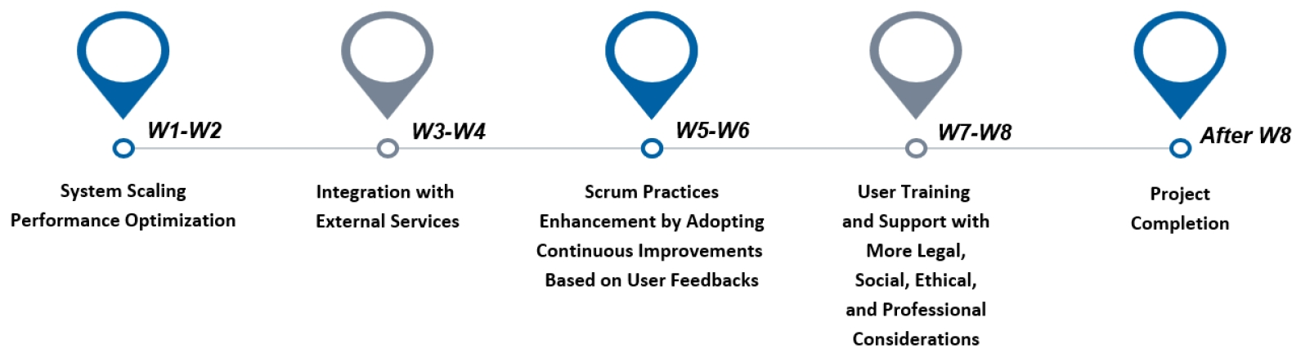


Conclusion
Development of a Web-based Meeting Room Booking System for Universities
Practical Adoption of the Scrum Framework throughout Iterative Sprints
Understanding of Legal, Ethical, and Security Considerations in System Design
Complete System Specification, Design, Implementation, and Evaluation
Achievement
Limited Frontend Styling
Unoptimized Query Performance
Lack of Automated Deployment
Problems in our project
Future work

